Slide 1

BREAST CANCER PREDICTION FROM PAST DATA’S BASED ON SUPERVISED MACHINE LEARNING
Batch ID:CS17A5
Dept: CSE
Team members: 17G01A0539
17G01A0507
17G01A0535
17G01A0518
Guide
Ms.K.Pujitha M.Tech Assistant professor

Slide 2
ABSTRACT
Breast Cancer is considered as one of the deadliest and chronic diseases which cause an increase in blood sugar. Many complications occur if Breast Cancer remains untreated and unidentified. The tedious identifying process results in visiting of a patient to a diagnostic center and consulting doctor.
But the rise in machine learning approaches solves this critical problem. The motive of this study is to design a model which can prognosticate the likelihood of Breast Cancer in patients with maximum accuracy.
Therefore three machine learning classification algorithms namely SVM and Logistic Regression are used In this experiment to detect Breast Cancer at an early stage.

Slide 3
INTRODUCTION
Breast cancer is the most frequent cancer among women and it is the second dangerous cancer after lung cancer.
Cancer starts when cells begin to grow out of control. Breast cancer cells usually form a tumour that can often be seen on an x-ray or felt as a lump.
Breast cancer can spread when the cancer cells get into the blood or lymph system and are carried to other parts of the body.
The cause of Breast Cancer includes changes and mutations in DNA.
Doctors can easily identify breast cancer by using Breast ultrasound, Diagnostic mammogram, Magnetic resonance imaging (MRI), Biopsy. Based on these test results, doctor may recommend further tests or therapy.

Slide 4
EXISTING SYSTEM:
This paper is to address this important problem and design a cloud-assisted privacy.
It preserving health records to protect the privacy of the involved parties and their data.
Thresholding method, K means clustering, manual analysis.
The outsourcing decryption technique and a newly proposed key private proxy re encryption are adapted.

Slide 5
DISADVANTAGES:
High resource costs needed for the implementation.
Medical Resonance images contain a noise caused by operator performance which can lead to serious inaccuracies classification.

Slide 6
PROPOSED SYSTEM:
Classification is one of the most important decision making techniques in many real world problem.
In this work, the main objective is to classify the data as diabetic and improve the classification accuracy.
For many classification problem, the higher number of samples chosen but it doesn’t leads to higher classification accuracy.
In many cases, the performance of algorithm is high in the context of speed but the accuracy of data classification is low.
Classification accuracy can be increase if we use much of the data set for training and few data sets for testing.
This survey has analysed various classification techniques for classification of diabetic and non-diabetic data.
Thus, it is observed that techniques like Support Vector Machine, Logistic Regression, and are most suitable for implementing the Breast Cancer prediction system.

Slide 7
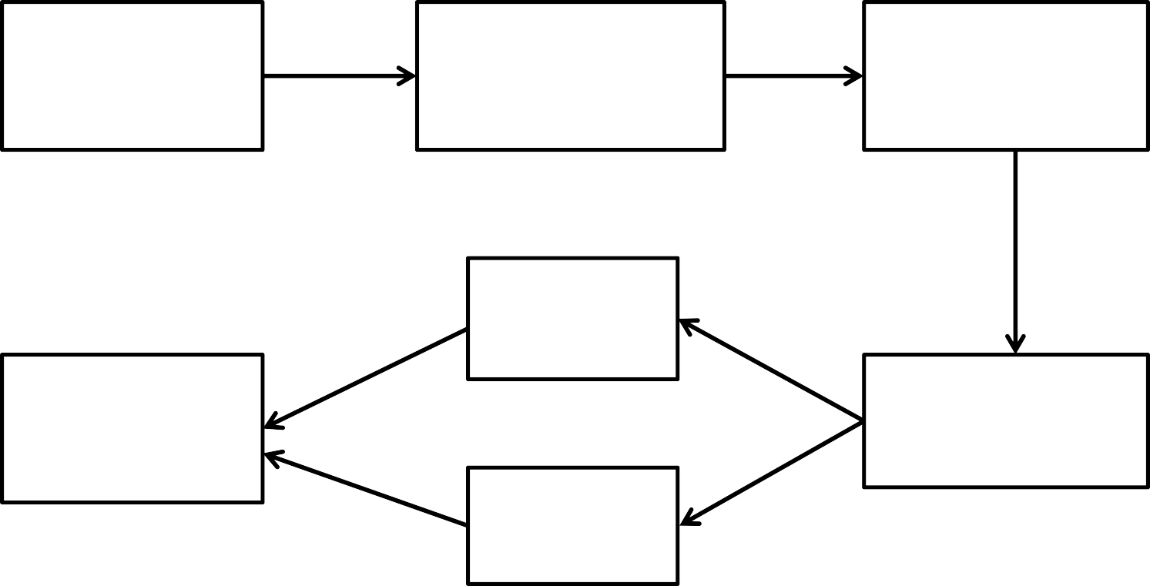
PROPOSED SYSTEM ARCHITECTURE:
Data set (Patients Data)
Logistic regression and
SVM
Classify the Data set
Random forest
Predict the Feature extraction
Results
Naive bayes

Slide 8
PROPOSED FRAME WORK
In vision of the problem statement described in the introduction section, a classification model is proposed with boosted accuracy to predict the breast cancer patient. The framework is composed of the
following important phases:
Dataset Collection
Data Preprocessing
Learning by Classifier (Training) i.e. SVM, Linear Regression and KNN.
Achieving trained model with highest accuracy
Using trained model for prediction

Slide 9
ALGORITHMS:
LR (LOGISTIC REGRESSION) :
Logistic Regression uses an equation like Linear Regression, but the outcome of logistic regression is a categorical variable whereas it is a value for other regression models. Binary outcomes can be predicted
from the independent variables. The general workflow is:
get a dataset
train a classifier
make a prediction using such classifier

Slide 10
2. KNN(K-NEAREST NEIGHBOUR):
K-Nearest Neighbour is a supervised machine learning algorithm as the data given to it is labelled. It is a nonparametric method as the classification of test data point relies upon the nearest training data points rather than considering the dimensions (parameters) of the dataset.
STEPS:
Input the dataset and split it into a training and testing set.
Pick an instance from the testing sets and calculate its distance with the training set.
List distances in ascending order.
The class of the instance is the most common class of the 3 first trainings instances (k=3)

Slide 11
SUPPORT VECTOR MACHINE:
  Support Vector Machine is a supervised machine learning algorithm which is doing well in pattern recognition problems and it is used as a training algorithm for studying classification and regression rules from data.
  SVM is most precisely used when the number of features and number of instances are high. A binary classifier is built by the SVM algorithm. In an SVM model, each data item is represented as points in an n-dimensional space where n is the number of features where each feature is represented as the value of a coordinate in the n-dimensional space.
Here's how a support vector machine algorithm model works:
    First, it finds lines or boundaries that correctly classify the training dataset.
    Then, from those lines or boundaries, it picks the one that has the maximum distance From the closet data points.

Slide 12
FEATURE EXTRACTION
Feature extraction is the important step in breast cancer detection.
The recent use of textural features and machine learning (ML) classifiers has established a new research direction to detect breast cancer. Texture features have been widely used as classification of masses indigital mammogram.
Texture features can be classified into three classes based on what they are derived from Gray Level Co- Occurrence Matrices (GLCM), Gray Level Difference Statistics (GLDS), and Run Length Statistics (RLS).
The implementation of feature extraction procedure relies on the quality of the texture, which is the main descriptor for all the mammograms.

Slide 13
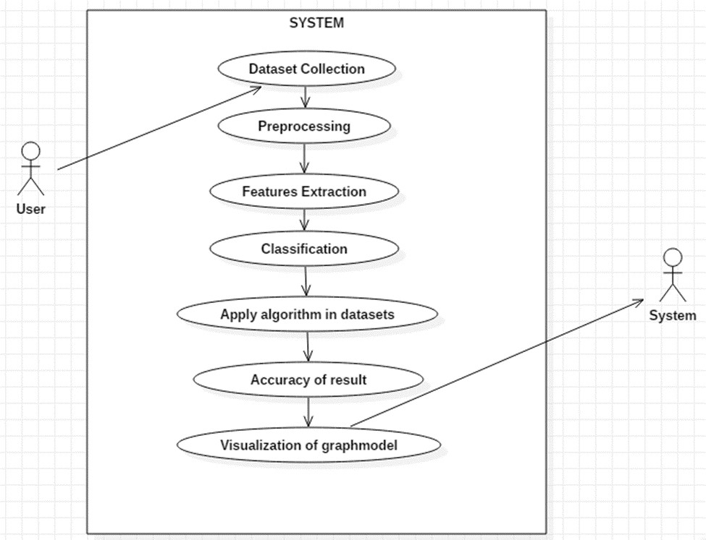
USE CASE DIAGRAM

Slide 14
IMPLEMENTATION
data.drop('id',axis=1,inplace=True) data.drop('Unnamed: 32',axis=1,inplace=True) data['diagnosis'] = data['diagnosis'].map({'M':1,'B':0})
datas = pd.DataFrame(preprocessing.scale(data.iloc[:,1:32])) datas.columns = list(data.iloc[:,1:32].columns) datas['diagnosis'] = data['diagnosis']
datas.diagnosis.value_counts().plot(kind='bar', alpha = 0.5, facecolor = 'b', figsize=(12,6)) plt.title("Diagnosis (M=1 , B=0)", fontsize = '18')
plt.ylabel("Total Number of Patients")
plt.grid(b=True)#Looking at the number of patients with Malignant and Benign Tumors: datas.diagnosis.value_counts().plot(kind='bar', alpha = 0.5, facecolor = 'b', figsize=(12,6)) plt.title("Diagnosis (M=1 , B=0)", fontsize = '18')
plt.ylabel("Total Number of Patients") plt.grid(b=True)

Slide 15
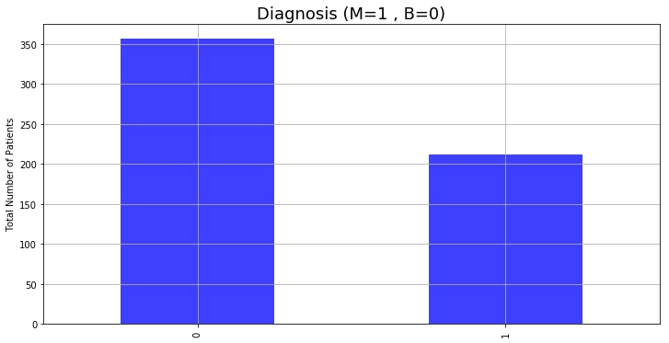
RESULTS

Slide 16
ADVANTAGES:
High accuracy, fastest prediction, and consistency of results.
It can segment the Breast Cancer regions from the data accurately.
It is useful to classify the lung Tumor from trained data set for accurate detection

Slide 17
HARDWARE AND SYSTEM CONFIGURATION:
Hardware:
Windows 10 (64 Bit)
Ram 4GB
Software:
Python 2.7
Anaconda Navigator Python’s Standard library:
Pandas
Numpy
Sklearn
tkmessageBox
Matplotlib

Slide 18
CONCLUSION
Breast cancer if found at an early stage will help save lives of thousands of women or even men. These projects
help the real world patients and doctors to gather as much information as they can. The research on nine papers
has helped us gather the data for the project proposed by us. By using machine learning algorithms we will be
able to classify and predict the cancer into being or malignant. Machine learning algorithms can be used for
medical oriented research, it advances the system, reduces human errors and lowers manual mistakes.

Slide 19
REFERENCES
Shomona G. Jacob, R. Geetha Ramani, "Efficient Classifier for Classification of Prognosis Breast Cancer Data through Data Mining Techniques", Proceedings of the World Congress on Engineering and Computer Science 2012, vol. I, October 2012.
C.L. Chi, W. N. Street, W. H. Wolberg, "Application of artificial neural network-based survival analysis on two breast cancer datasets", American Medical InformaticAssociation Annual Symposium, pp. 130-134, Nov. 2007.
D. Delen, G. Walker, A. Kadam, "Predicting breast cancer survivability: a comparison of three data mining methods", Artificial Intelligence in Medicine, vol. 34, no. 2, pp. 113127, 2004.
https://towardsdatascience.com/building-a-simple-machine-learning-model-on-breast-cancer-data- eca4b3b99fa3
https://www.ijitee.org/wpcontent/uploads/papers/v8i6/F3384048619.pdf
https://ieeexplore.ieee.org/document/7943207

Slide 20


